Slide 1
Annotation:
The art of taking meaningful notes while reading.
Annotation is often required in college, but if you don't know what you're doing, then where do you start?

Slide 2
HOW DOES IT HELP ME?
Annotating helps you remember what you read because you are involved closely with the text.

Slide 3
Annotating helps you study and take tests; both will be easier after learning this important note-taking skill.

Slide 4
Annotating is the only way to go back into a text and easily find what you need.
There is no easier way to locate key points in material you have read.

Slide 5
Follow these steps!

Slide 6
Gather your supplies.
Annotation requires pens and pencils—and maybe highlighters.
You also need a dictionary.
Sticky notes (like Post-Its) are also helpful, although they are not necessary.

Slide 7
Highlighters:
They are colorful and fun--and work best when you have only a few things to note.
But, the bright colors draw your eyes to them and can often make studying confusing because the colors attract you.
Avoid highlighting when you know you will be making a lot of notes on the page.

Slide 8
To begin: read the first paragraph and pick out the main idea.
Ask yourself: What sentence effectively sums up what the passage is saying?
Underline the main idea—maybe twice: The marks you use to annotate are your own set of symbols. You decide what ones you will use. Be consistent.

Slide 9
Underline (or double underline—depending on importance) the main idea in the next paragraph the same way —and the next, and the next.
Repeat this step for each paragraph unless they are simple “transition” paragraphs with no main idea. Transition paragraphs don’t have meaningful content.

Slide 10
Number items that are intentionally put in sequence:
1, 2, 3/a,b,c…..so you can see the process or the list the author makes.

Slide 11
Determine another way to note detail that supports the main idea. Perhaps underlining, boxing, circling….supporting examples, evidence, data could be important, especially on a test.

Slide 12
If you don't understand the material you are reading, you may not be able to identify whether or not the idea is important.

Slide 13
When you don’t understand, continue reading to see if you come to a place you do comprehend.
If this doesn’t happen soon, begin again and take apart sentences to figure out meaning of the smaller parts.
Write down the meaning of the parts you didn’t understand at first--in the margins.

Slide 14
When unfamiliar words stop you because they are important to the meaning, look for context clues before and after the word. If you still don’t understand, circle the word and look up its meaning in a dictionary. Write the definition near that circled word.

Slide 15
What about other words
I don’t know?
Circle them and look them up later to improve your vocabulary if you like.
If they are not critical to meaning, don’t stop reading to get a definition.

Slide 16
Margin Notes:
Turn your book around to write longer notes, as needed. The margins are narrow!

Slide 17
Arrows are helpful
Use them to connect an author’s ideas to each other.
Use them to tie your own margin notes together.

Slide 18
Note the thesis—the largest main idea—differently and specially.
When it is directly stated, mark it to readily see it.
Maybe you put a star * or a large “T” next to it after underlining—something unique to catch your eye.

Slide 19
When the author doesn’t directly state the thesis but suggests it (indirectly stated), then you should write out the author’s main point in your own words the margin and, again, note it with a special mark.

Slide 20
Your response is important, so annotate it, too. Your notes are not totally about the author’s ideas, but about your reaction, as well.

Slide 21
In margin notes you can include comments you have about the information—like questions, opinion, arguments. Use exclamation points, question marks—any symbol you understand.
Again, be consistent with your symbols.

Slide 22
SAMPLES of Annotation

Slide 23
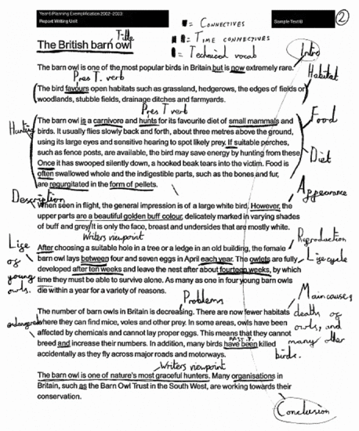

Slide 24
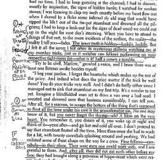

Slide 25
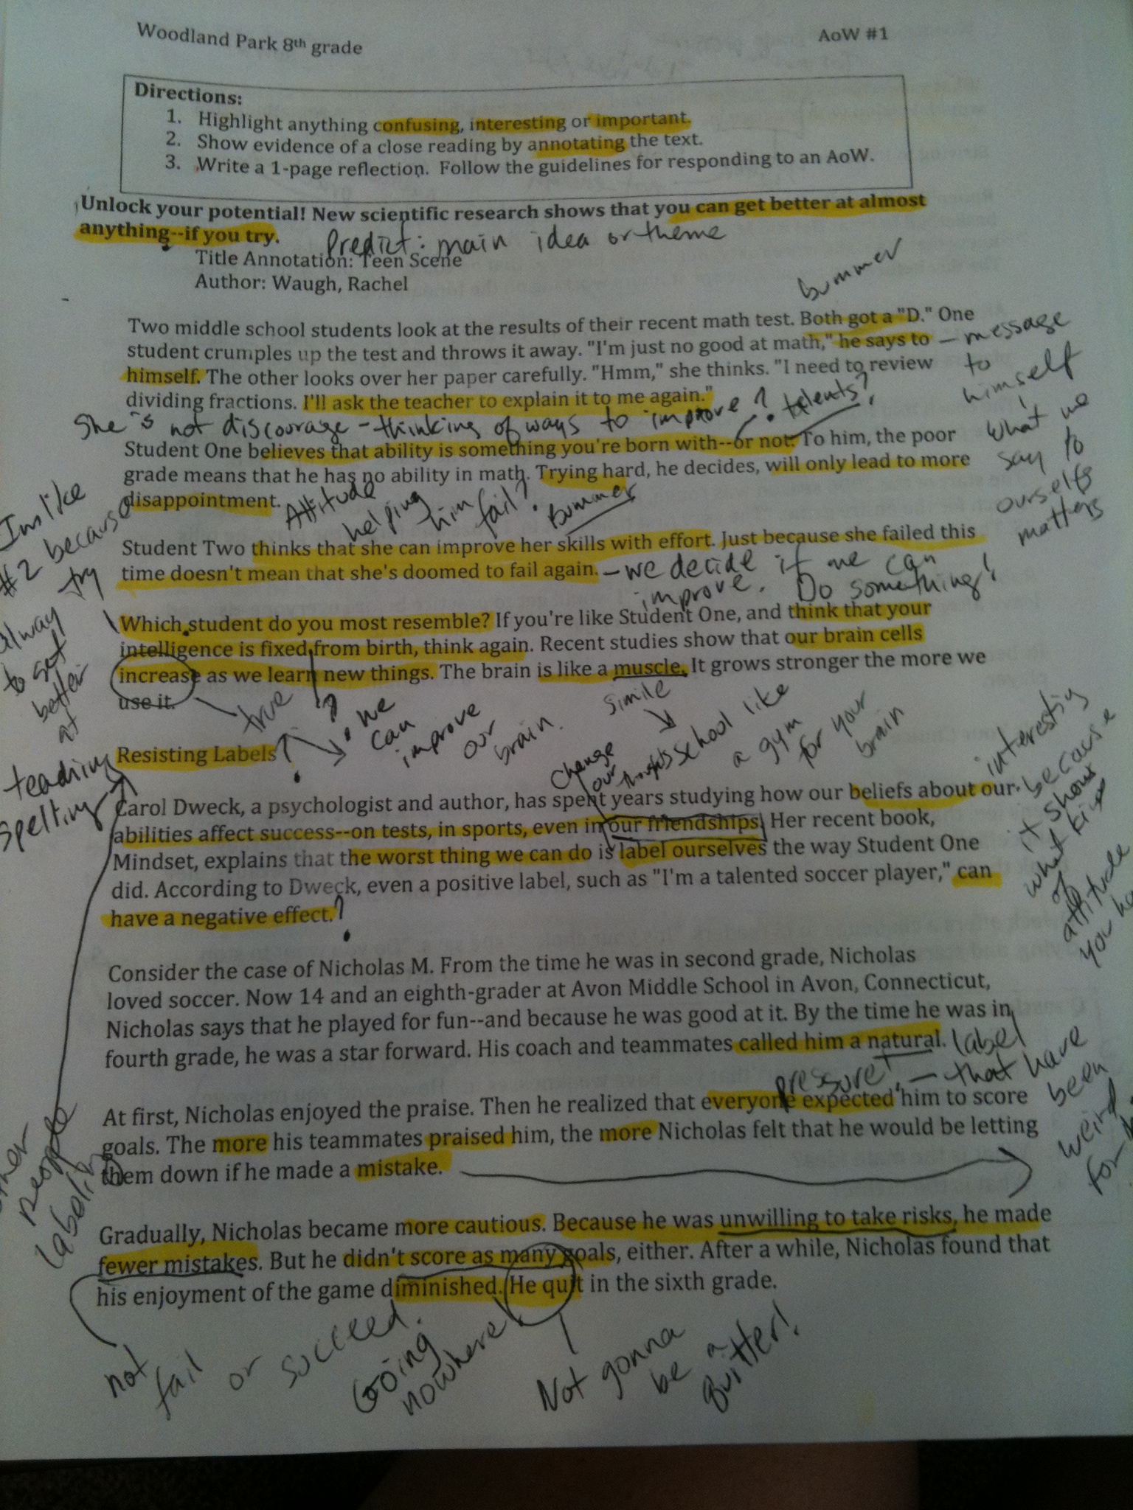

Slide 26
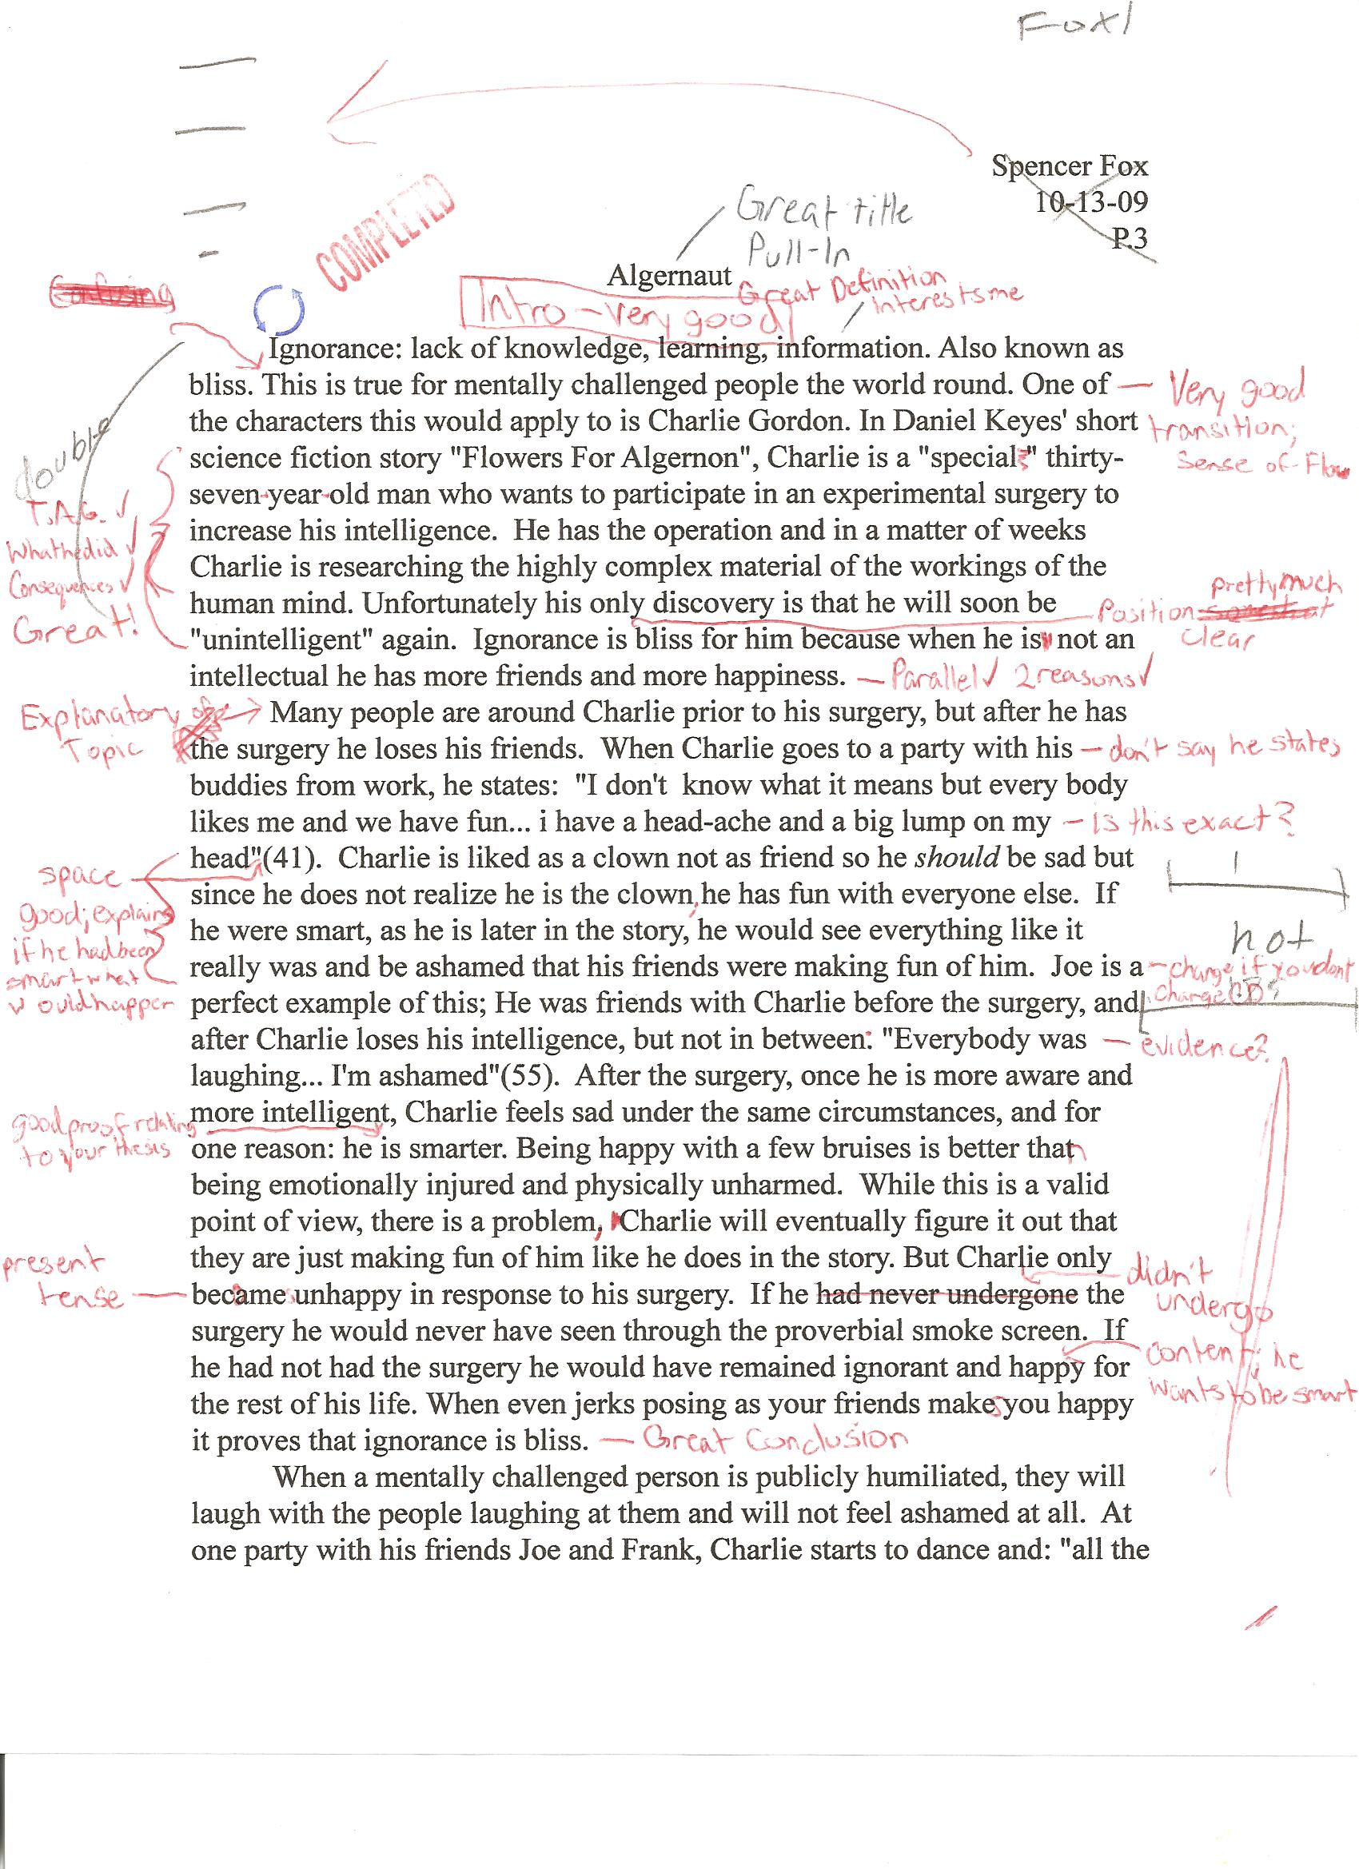

Slide 27
QUESTIONS or COMMENTS?

