Slide 1
Brides of Eden Preview of Themes
Characteristics of
Destructive Religious or Terrorist Groups

Slide 2
Cult?
The term is often used for a destructive group, but “cult” does not actually have a negative meaning.
“Cultus” is the latin root. It means to learn—to gain wisdom.
Extreme movements that do damage to their followers and/or others are what this presentation is about. We will refer to them as “extreme” or “destructive”—not as cults.
Religious groups that believe differently than most in society are only different from the norm.

Slide 3
Eight Conditions of “Thought Reform” (Brain-washing)
Robert Jay Lifton, M.D—1963
Thought Reform and the Psychology of Totalism: A Study of "Brainwashing" in China, about prisoners in China and Korea.

Slide 4
1. Control of Environment and Communication
The leader establishes rule over the individuals’ communication with the outside world--all that the follower sees and hears, reads and writes, experiences, and expresses.

Slide 5
2. Mystical Manipulation
Experiences are designed to appear to be spontaneous and spiritual when, in fact, they are created by the leader(s).
People mistakenly believe that their experiences have spiritual causes when, in fact, they are created by human beings.

Slide 6
3. Demand for Purity
Demanding that the followers be “perfect” in some way creates guilt and shame by holding up standards of perfection that no human being can attain.
Followers are punished and learn to punish each other for not living up to the group's ideals.
Member’s old attitudes and beliefs are not pure and must be changed.

Slide 7
4. Confession
Public confessional is used to get members to tell their deep fears and anxieties as well as imperfections.
Followers loose their sense of personal boundaries They come to believe that their thoughts, feelings, or actions that do not conform with the group's rules must be confessed.
By confessing, members have little or no privacy.

Slide 8
5. Aura of Sacred Science
The leader insists that the group’s laws, rules and regulations are special and holy so must be followed.
The leader insists that the group’s beliefs are scientific and morally true.
No alternative viewpoint is allowed and no questioning of the beliefs or rules is permitted.

Slide 9
6. Loaded/Simplified Language
The most profound and complex human problems are compressed into brief bumper sticker type phrases that are easily memorized and easily expressed.
The group uses black-or-white thinking and clichés (simple phrases)that don’t take the “big picture” into consideration.

Slide 10
7. Doctrine over People
The value of individuals is insignificant when compared to the value of the group.
Past events are altered, rewritten, or ignored to make them consistent with doctrine.

Slide 11
8. Only Some Deserve Life
The leader/group decides who has a right to exist and who does not.
Former members are seen as "weak, " "lost," "evil," and "the enemy".
The group/leader insists that there is no legitimate alternative to membership in the group.

Slide 12
Examples of Destructive Leaders/Groups
Branch Davidians—Waco, Texas: 38 people died in a fire after a stand-off with the US government. David Korresh was the leader.
People’s Temple—Guyana, South America: 909 people took their own lives after the leader, Jim Jones, told them to drink poison Kool-Aid. Others were killed at a local airport when some members wanted to leave.

Slide 13
Jim Jones

Slide 14
Jim Jones with Governor Brown, California

Slide 15
Jim Jones before Guyana

Slide 16
Deaths at Jonestown, Nov 1978

Slide 17
Heaven’s Gate, California: Marshall Applewhite

Slide 18
Group believed that in death they would join a UFO trailing the Hale Bopp comet

Slide 19
Members dressed alike to prepare for death.

Slide 20
Aum Shinrikyo—Japan: Subways in Tokyo were filled with poison gas.

Slide 21
Tokyo subway Aum Truth Supreme victims

Slide 22
Mt. Carmel, Waco, Texas: Branch Davidians

Slide 23
David Korresh, Leader

Slide 24
Mt. Carmel went up in flames after a standoff with government officials went on for weeks.

Slide 25
Everyone in the building died—some may have committed suicide and some died from the fire.

Slide 26
Tanks were used to break down walls of the buildings.

Slide 27
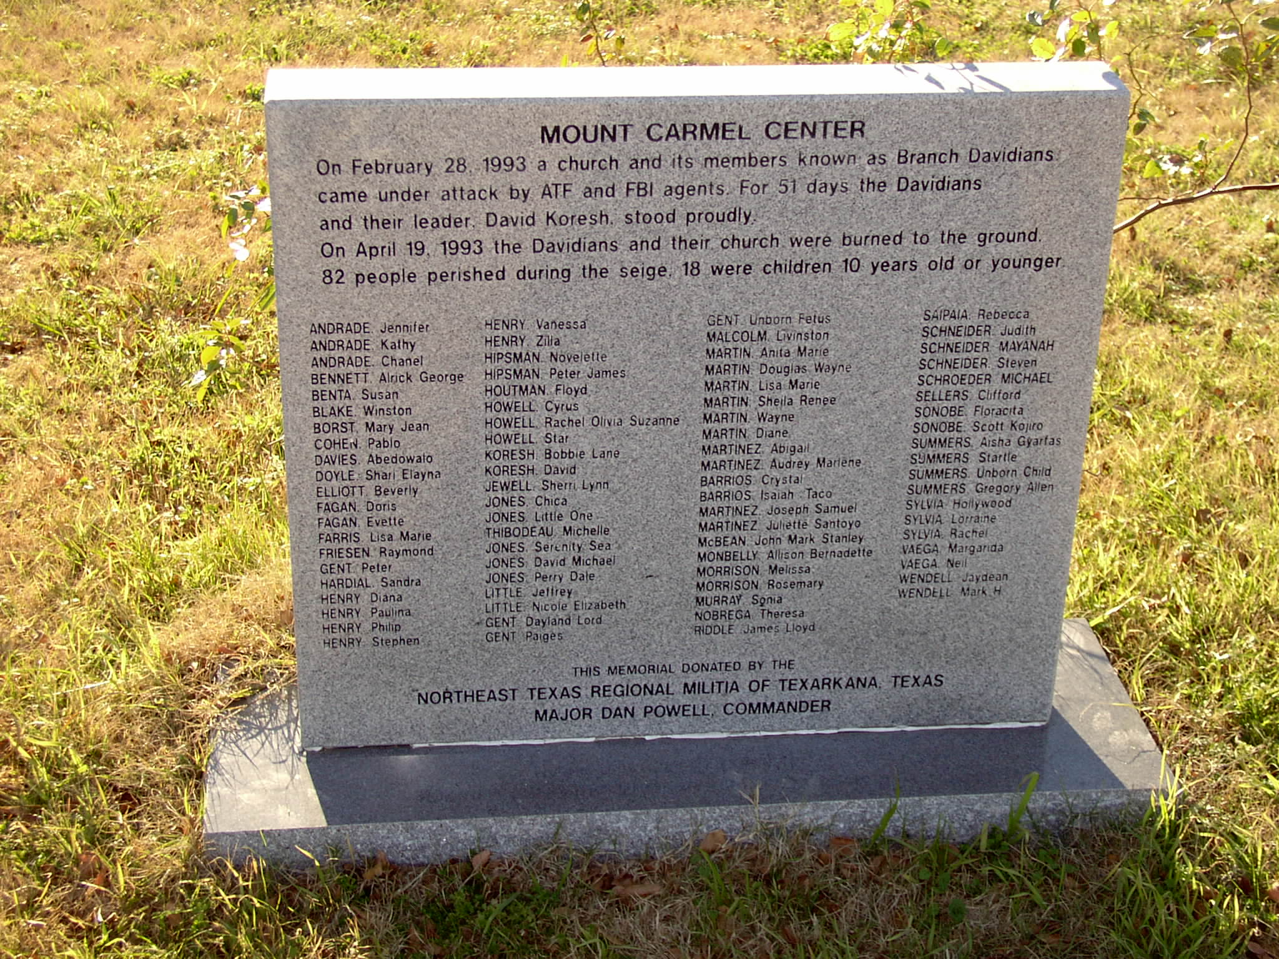
Mount Carmel in flames.

Slide 28
Most extreme groups harm no one. The Green polygamous family in Utah might be an example of this.

Slide 29
Polygamous mothers from the FLDS sect at Waiting for Zion Ranch in Texas after their children were taken into custody. The children were returned.

Slide 30
Boys in the FLDS sect. Leader’s photos.

Slide 31
Questions About Right to Believe as We Wish—Religious Freedom
When are extreme religious groups destructive and when are they simply unusual?
What constitutional right do people have to practice their own beliefs?
Who is vulnerable to destructive group leaders? Should followers be “rescued.”
Should government or citizens intervene? When?

